Slide 1
Lab 17. Use decoder to implement one bit adder

Slide 2
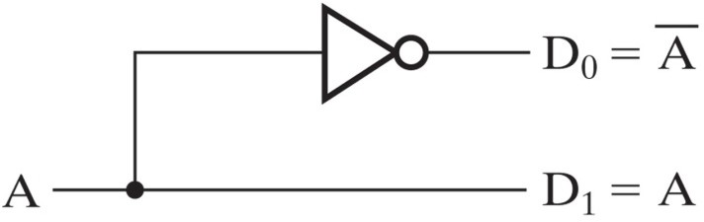

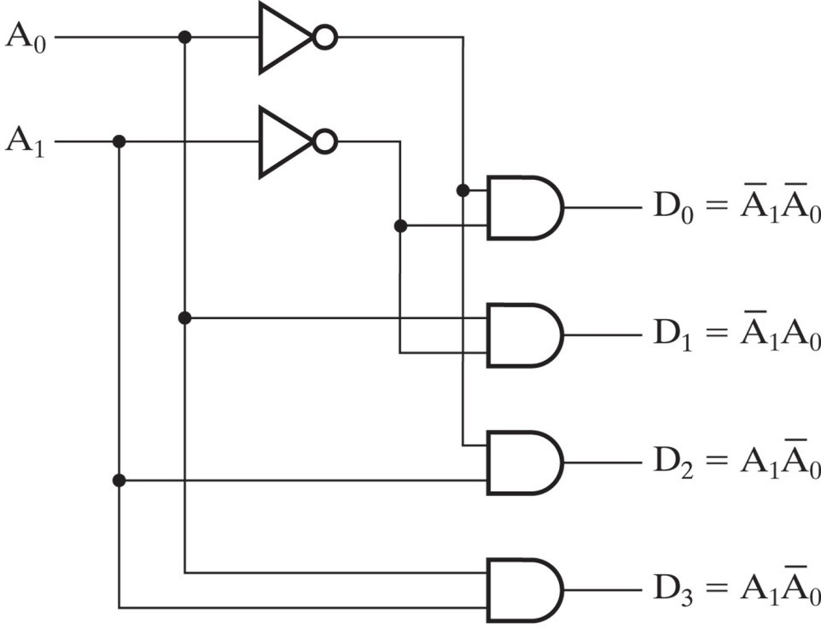

1-to-2-line decoder:
A’
A | D₀ | D₁
0 | 1 | 0
1 | 0 | 1
A
2-to-4-line decoder:
A₁ | A₀ | D₀ | D₁ | D₂ | D₃
0 | 0 | 1 | 0 | 0 | 0
0 | 1 | 0 | 1 | 0 | 0
1 | 0 | 0 | 0 | 1 | 0
1 | 1 | 0 | 0 | 0 | 1
A1’A0’
A1’A0
A1A0’
A1A0

Slide 3
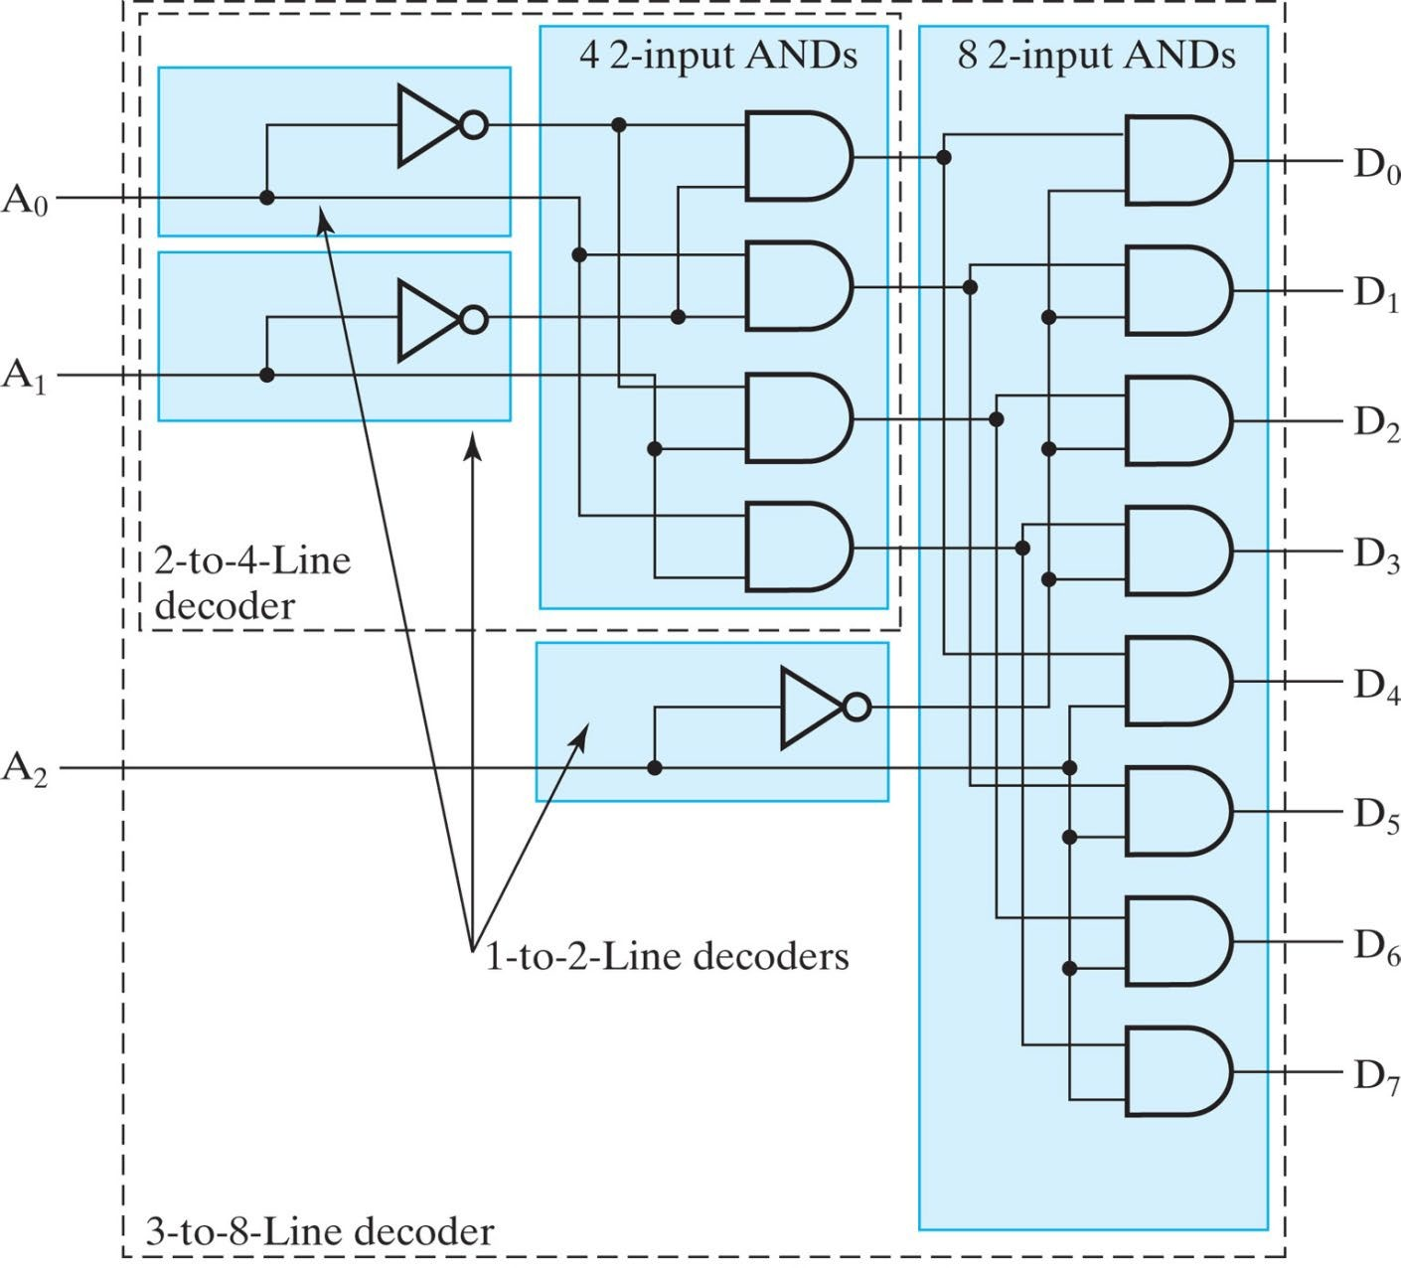
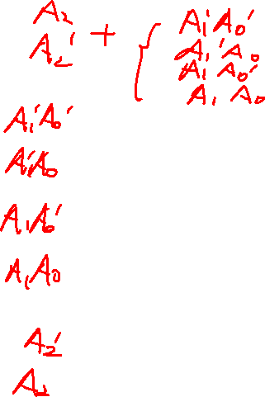
3-to-8-line decoder:

Slide 4

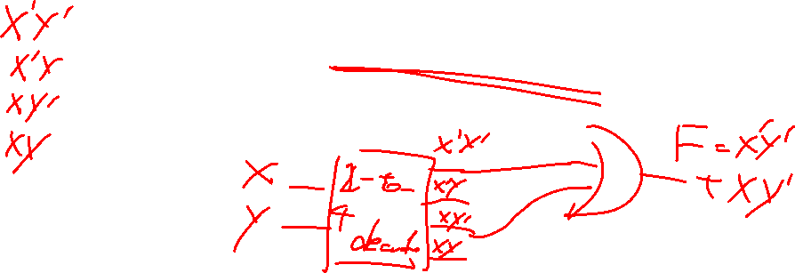
Decoder-based circuit
Any Boolean function can be implemented using a decoder and an OR gate
X | Y | Z
0 | 0 | 1
0 | 1 | 0
1 | 0 | 1
1 | 1 | 0
Z(X, Y) =X’Y’+XY’

Slide 5
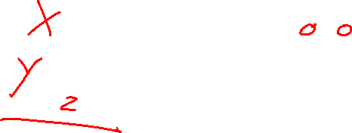
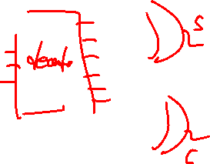
Decoder-based circuit (one-bit adder)
Use decoder to design a one-bit adder, which can be used to calculate X+Y, Z is the carry in. C is the carryout and S is the result. First complete the truth table and use decoder to implement this circuit.
X | Y | Z | C | S
0 | 0 | 0
0 | 0 | 1
0 | 1 | 0
0 | 1 | 1
1 | 0 | 0
1 | 0 | 1
1 | 1 | 0
1 | 1 | 1

Slide 6
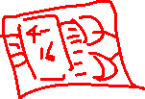
Requirements
Use three constant components to generate the input, X, Y, Z
Complete the 3-to-8 decoder first(you are free to create the decoder
as a subsystem or not) and use the output of decoder to make the
connections to implement one bit adder.
Use two scopes to observe C(carry-out) and S(result).
Set the input as 101 and 111 to see if the outputs are correct. If not
checked in class, take the screenshot of the structure of the circuit(if configure
the decoder as subsystem, also take the screenshot of the inner structure of
the subsystem) and the plots on two scopes according to 101 and 111 as inputs.
Submit all screenshots to canvas.

